Slide 1
Whole-Food, Plant Based Diet

Slide 2
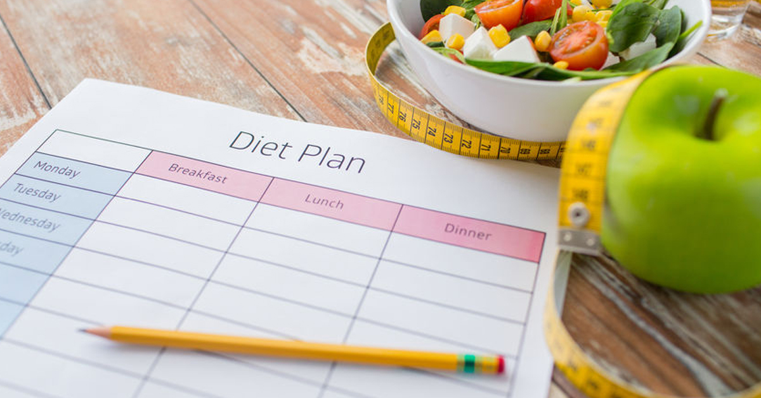
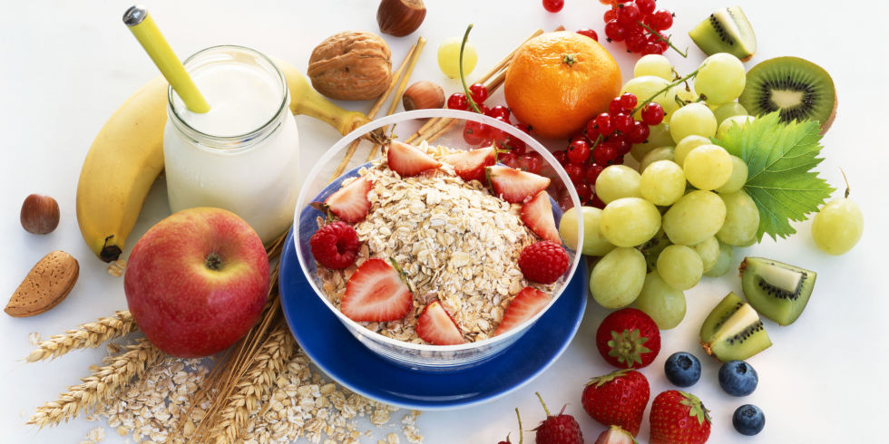
What is a Diet?
There are thousands of diets in the world that exist for many reasons.
They can help you lose weight, gain weight, lower cholesterol, live a healthy life and many other reasons.
A diet is described as a fixed plan of food and drink consumption where the types of food are planned in order to reach a specific goal or follow a particular lifestyle.

Slide 3
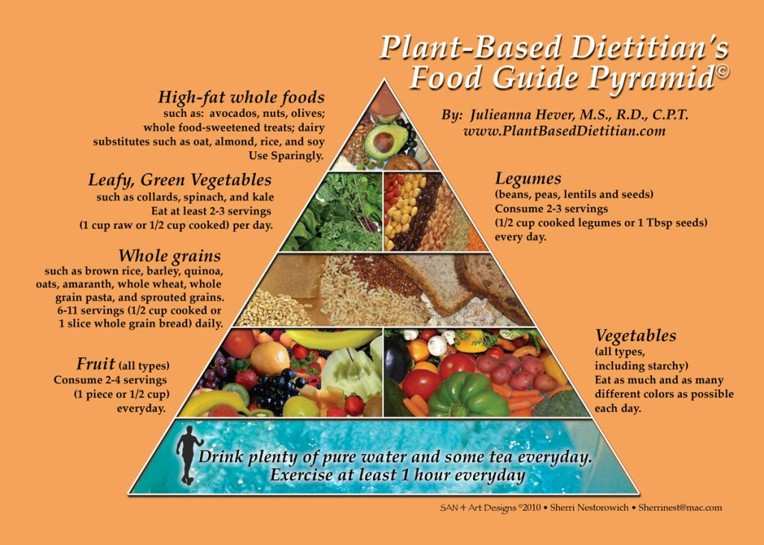
One very popular diet is called a whole foods or plant based diet.
This diet is centered around whole, minimally refined or unrefined foods.
It is based on fruits, vegetables, tubers, legumes, and whole grains.
It also minimizes or excludes meats such as red meats, chicken, or fish.
Also not included are dairy products such as eggs and cows milk as well as highly refined foods such as bleached flour, refined sugar, and oil.

Slide 4
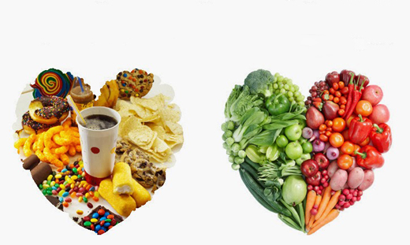
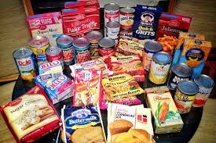
Important Terms
Refined Foods:
A refined food is a food that does not contain all of its original nutrients.
Refined foods can also be referred to as processed.
However, not all processed foods are bad for you. Some healthy processed foods are canned chickpeas, frozen veggies, unsweetened almond milk, granola, etc.
Some examples of refined foods are oil, sugar, white flour, white and wheat breads, wraps, and many more.

Slide 5
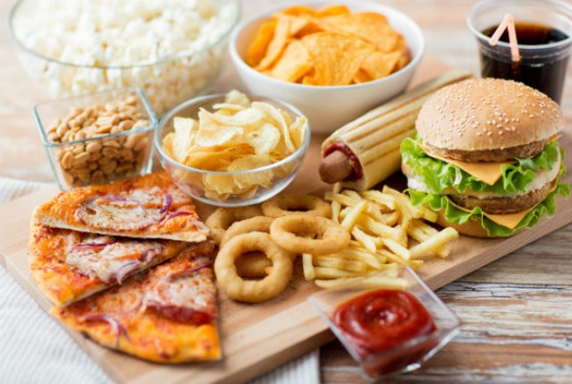
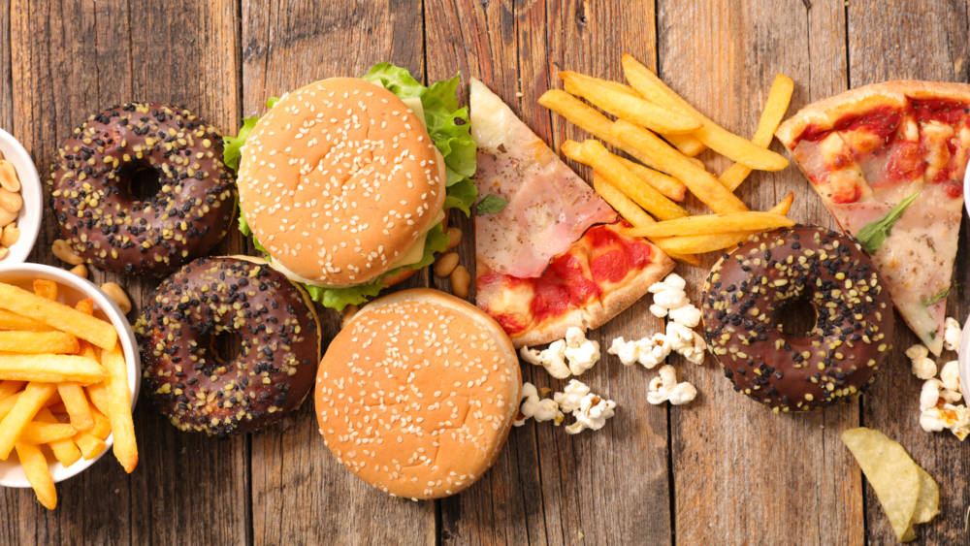
Processed
A food that has gone through a process.
A processed food can be a refined and it can also be a whole food that has simply been chopped, or ground (gone through a process).
Most processed foods are not involved in this diet and some examples are crisps, cookies, most crackers, cakes and many more.
These types of processed foods are bad because they contain refined ingredients.
However, some processed foods that are good for you are pitas, pastas, dried fruits, frozen vegetables, etc.

Slide 6
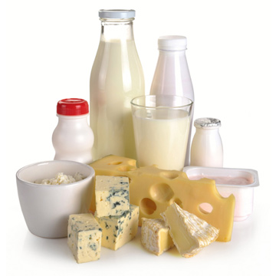
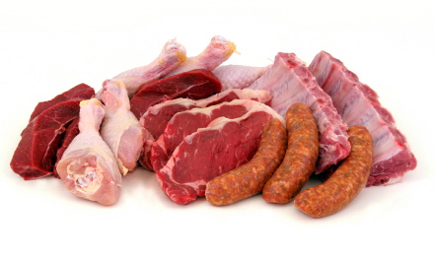
Animal Based vs Plant Based
Animal Based Foods (ABF):
Any food items that come from an animals source such as eggs, cheese, yogurt, milk and meat.
ABF’s such as poultry, dairy, fish, eggs and meat provide no fiber.
In order to have a sufficient amount of protein, people tend to eat large amounts of animal foods such as chicken, sometimes completely eliminating plant products. This causes fiber deficiencies.
The average male should eat about 38g of fiber per day but on average they only eat 15g.

Slide 7
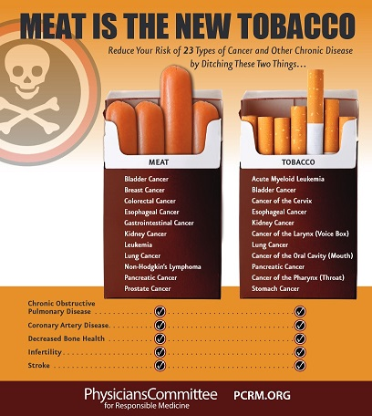
High fiber intake is associated with decreased cancer risk
Animal proteins have higher amounts of amino acids.
When this is consumed, it results in the body producing higher levels of insulin.
This hormone results in cell growth and division in both healthy and cancerous cells.

Slide 8
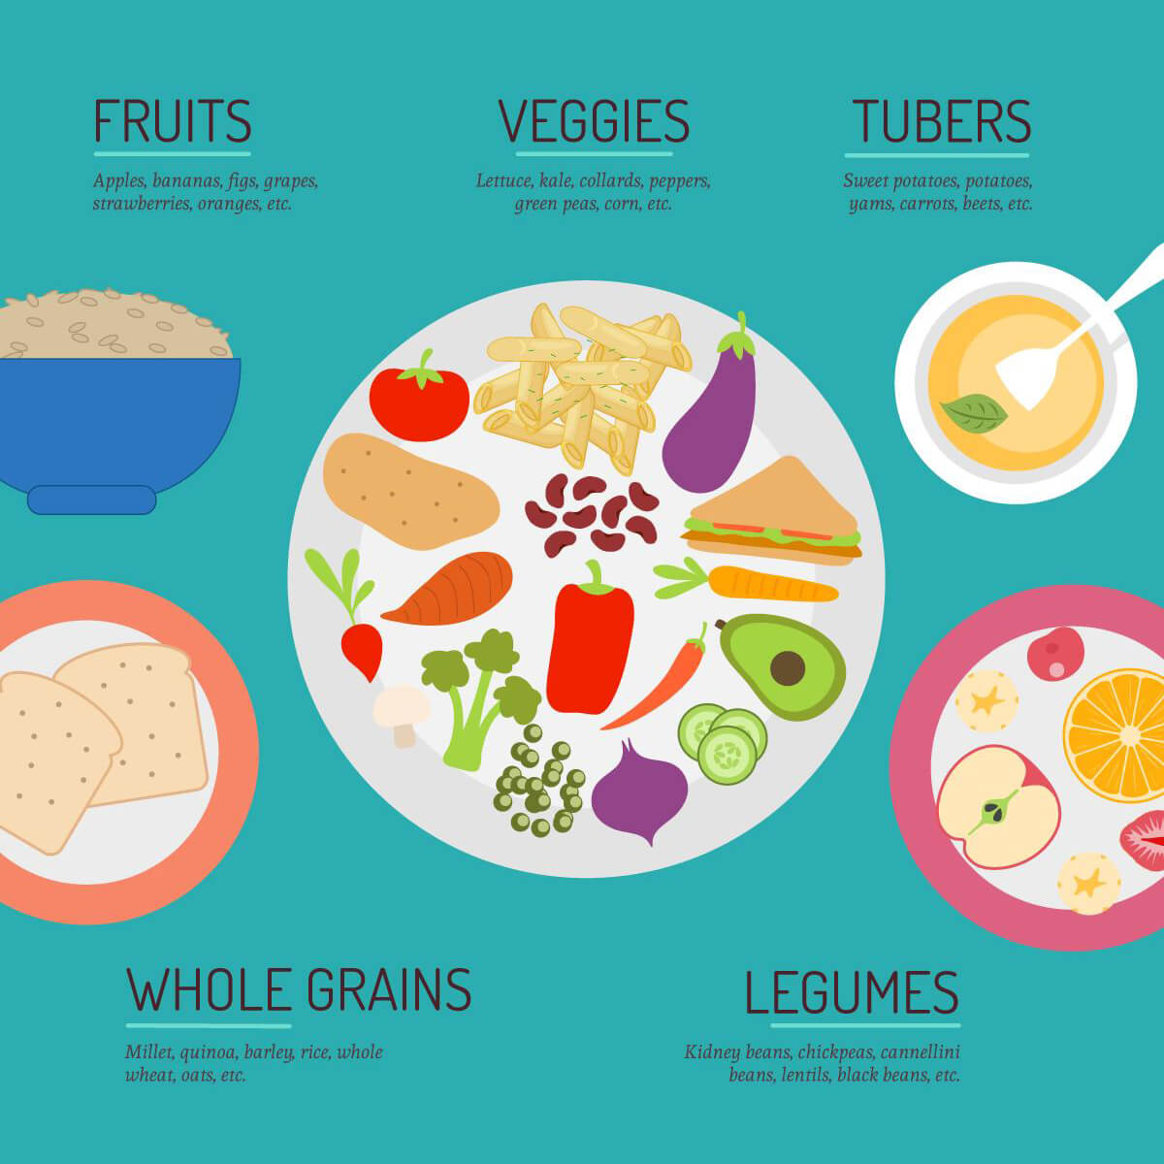
Animal Based vs Plant Based
Plant Based Foods:
Any foods that are derived from plant sources.
Ex. Fruits & Vegetables, lentils, peas, quinoa, seeds, nuts, tempeh/ organic tofu.
When following a plant-based diet they consume whole foods or very minimally processed. Ex. Frozen corn and corn on the cob would be considered “plant based”, but High Fructose Corn Syrup would not
Some examples of minimally processed foods would be guacamole, hummus, salsa, peanut butter, oatmeal, vegetable broth, etc.

Slide 9
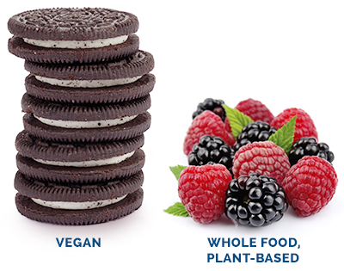
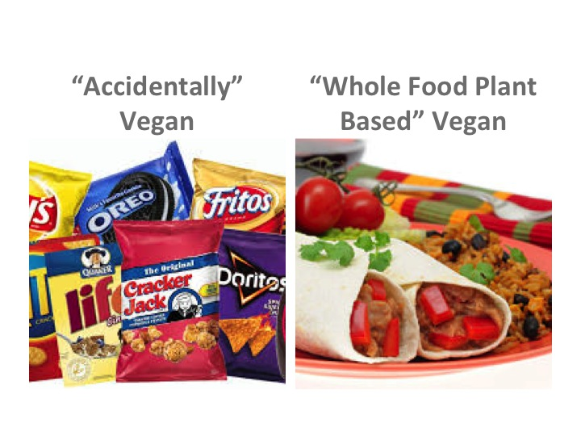
Vegan vs. Plant Based
Important to recognize that there is a difference between plant based and vegan.
While there are many differences, it is important to realize that something plant-based may be considered vegan but something vegan is not always plant-based.
Ex. Oreos are actually vegan but they are obviously not plant-based.
Generally speaking, people usually adopt a vegan diet due to animal rights issues and people on a whole foods and plant based diet usually adopt it for their health.

Slide 10
My Opinion
I think that this is a good diet to follow. This is because it is easy to maintain as it does not completely eliminate all meats.
It is not as extreme as veganism but it will also ensure a healthy lifestyle

