Slide 1
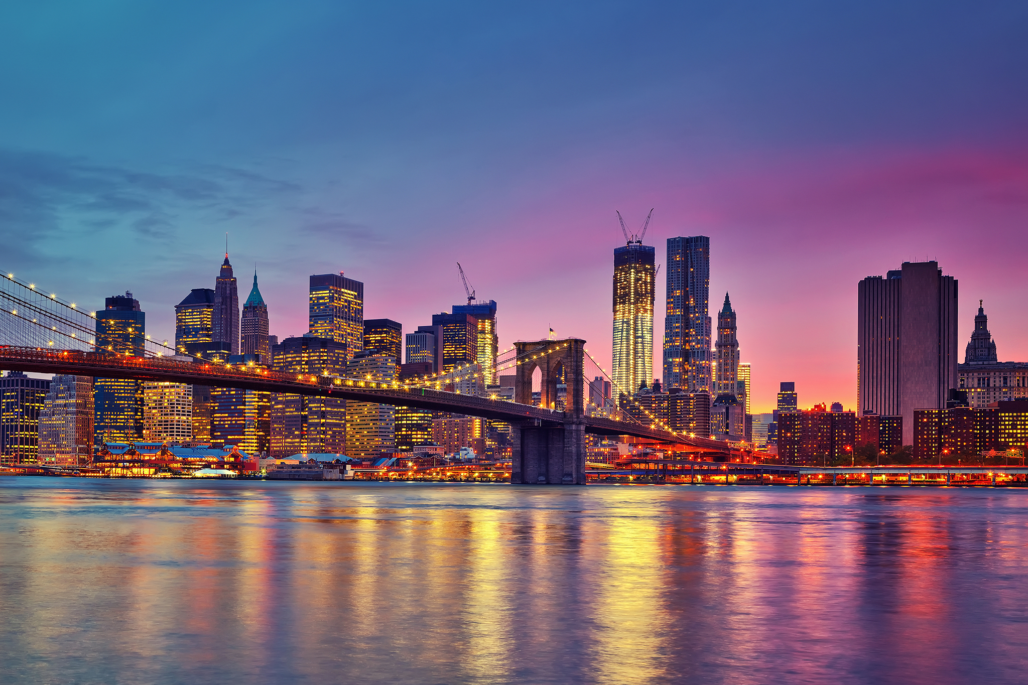
New York
By: Lily-Kate Hearns and Alex Loughlin

Slide 2
Flag
Excelsior: Latin word meaning “higher”, “superior”, “lordly”, and commonly translated as “ever upward.”
The flag displays the State Coat of Arms which was adopted in 1778.
On the right of the shield there is “justice”.
The other woman is “liberty” and she symbolizes freedom.

Slide 3
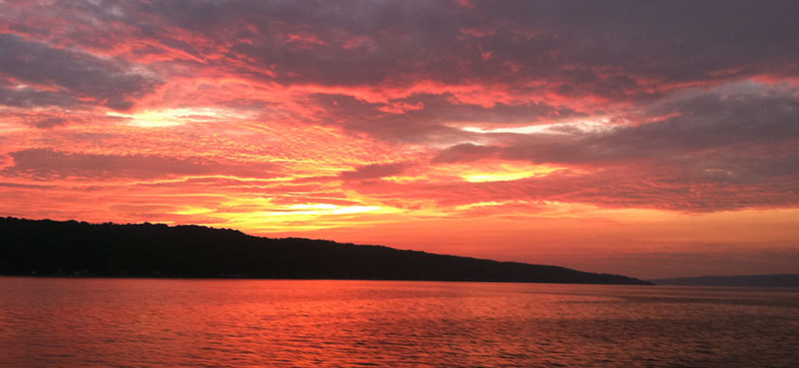
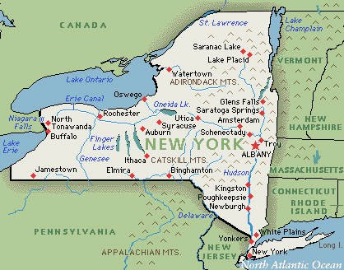
Geography
Bordered by Canada and lake Ontario in the north.
Pensylvania, New Jersey, and the Atlantic Ocean in the South
Lake Erie in the West
Connecticut, Massachusetts, and Vermont in the East.
Population: 8,550,405
Rivers: Hudson River, Delaware River, St Lawrence River, Niagara River.
Lakes: Cayuga, Seneca, Lake Ontario, Keuka Lake, Owasco Lake.
Mountains: Whiteface Mountain, Mountain Marcy, Mount Haystack.

Slide 4
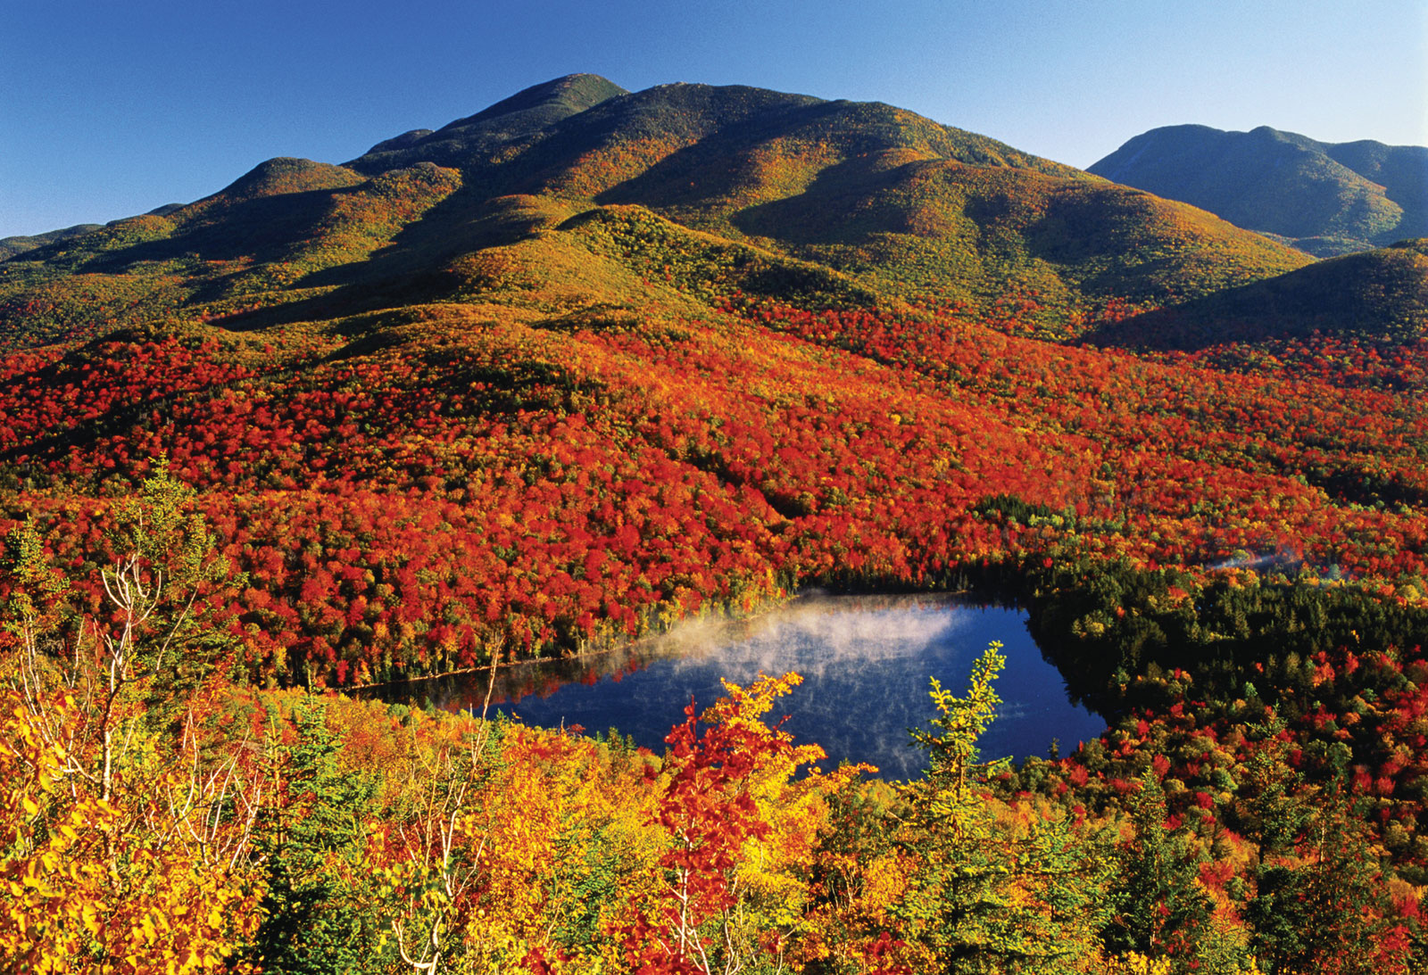
Topography
Two upland regions – the Adirondack Mountains and the Appalachian Highlands.
States highest peaks: Mt. March (1,629m) and Algonquin Peak (1559m)- found in Adirondacks.
Adirondacks forest covers most of this terrain.

Slide 5
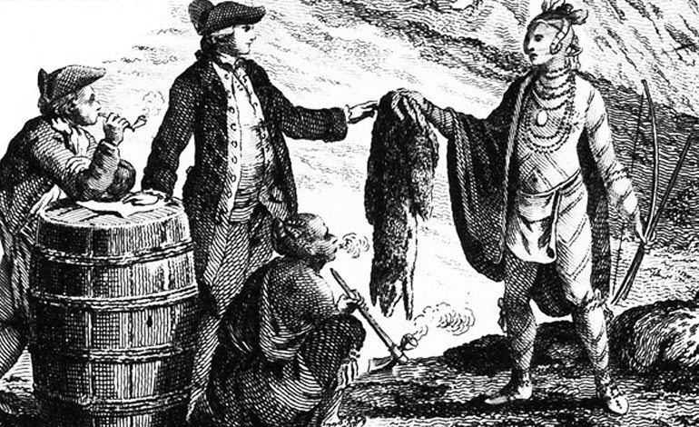
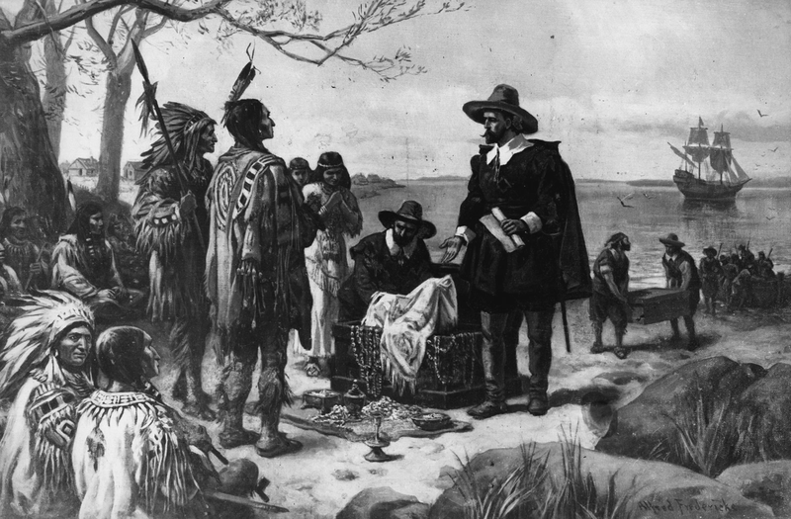
History
At around 10000 BC the first Native Americans arrived in this state
The discovery of New York was lead by the French in 1524 and the Dutch claimed the land in 1609.
This colony became part of New Netherlands and was a key part in the fur trade as it was now an agricultural resource
In 1626 the Dutch decided to buy Manhattan from the Natives
New York played a vital role during the American Revolution.
The Stamp Act Congress - 1765
The Sons of Liberty

Slide 6
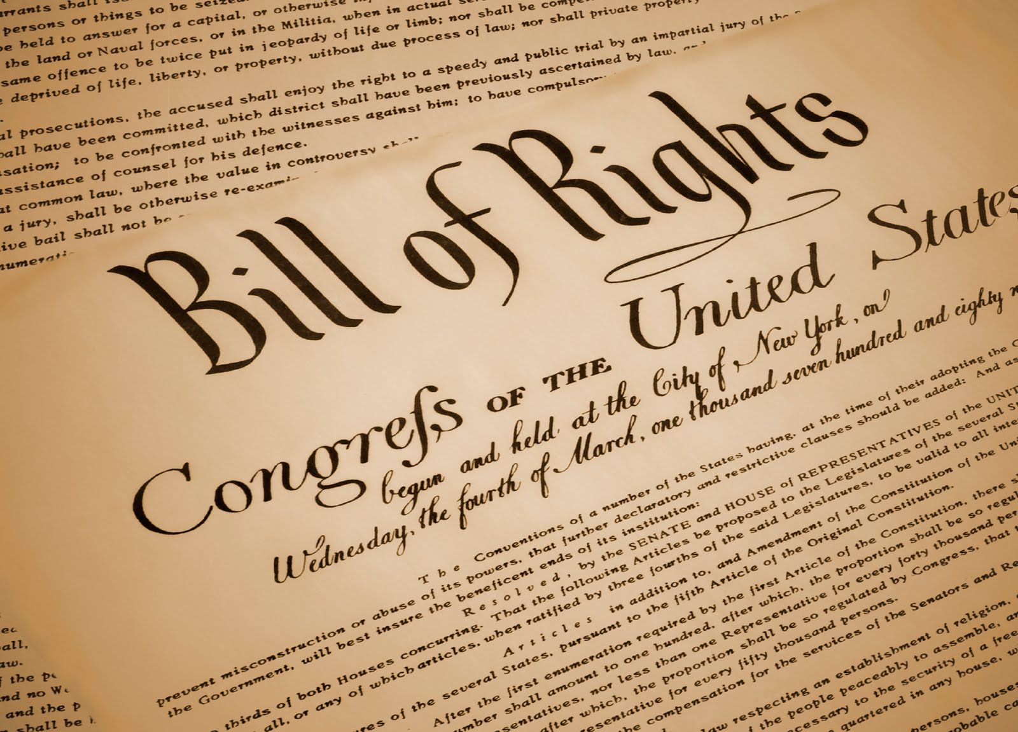
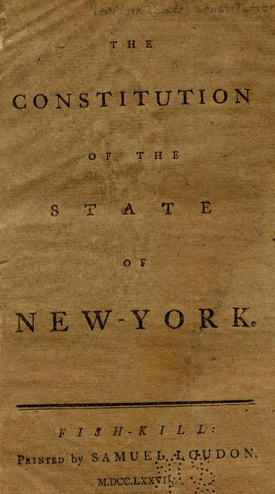
History Pt. 2
After many defeats, the Dutch to fled from the New York area, leaving the important port and harbor to the British.
New York became the British armies North American base for the rest of the war.
New York's constitution was adopted 1777.
New York City became the national capital and this is where the Bill of Rights was drafted.
New York made transportation advancements such as the first steamboat in 1807, the Erie Canal in 1825 and first scheduled railway service in 1831
These advancements lead to expansion and many settlements .

Slide 7
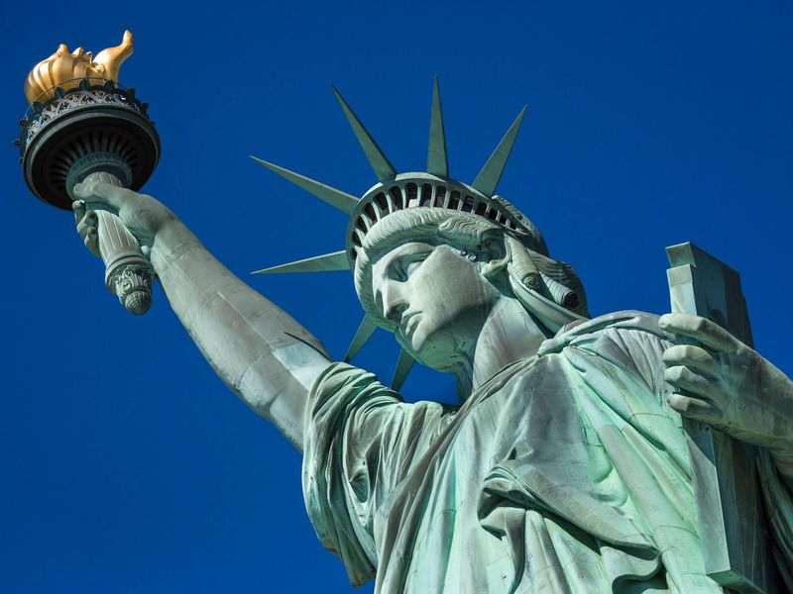
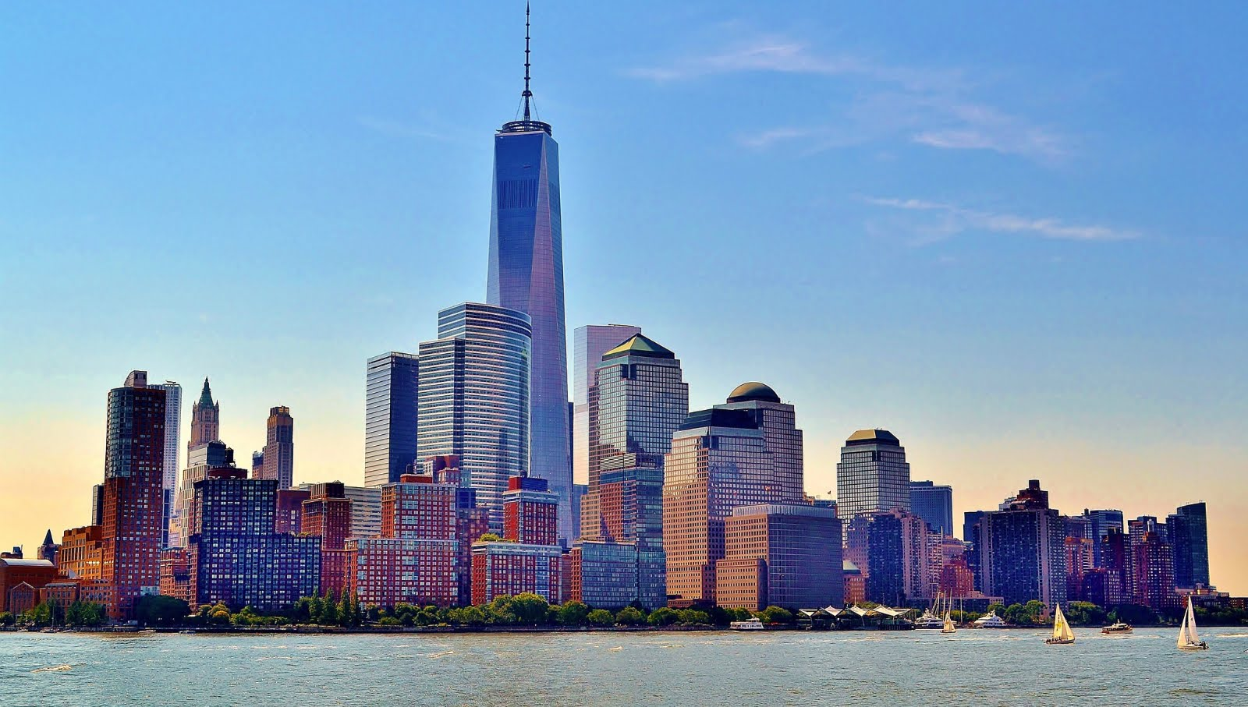
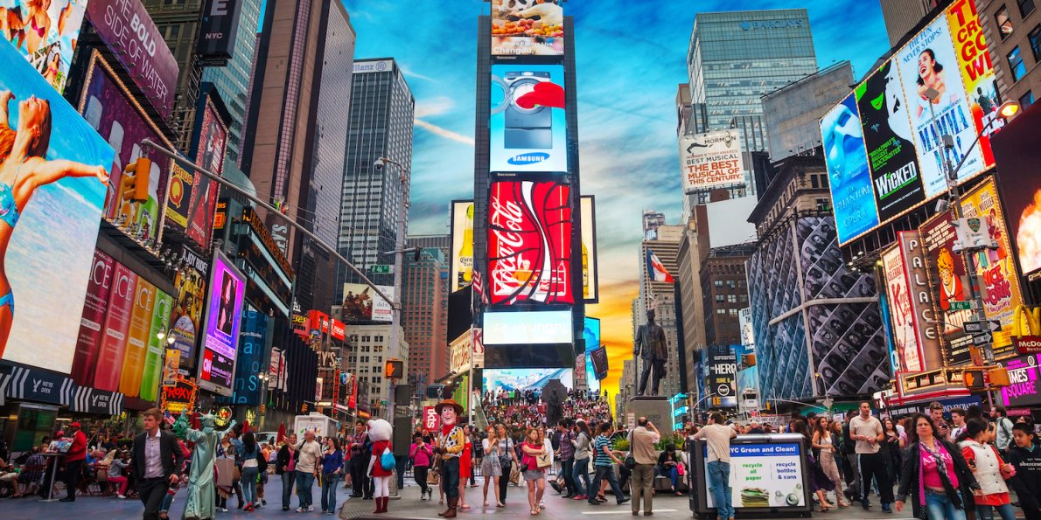
What its Famous for Today
Today New York City is one of the most famous cities in the entire world for many reasons.
It has the most iconic skyline in the world. It is home of the Empire Stat Building (443m), the Chrysler building, the Woolworth building, and the twin towers (replaced with the One World Trade Center)
New York is the home of musicals and they make productions superior to any other city. The most memorable shows of our time were developed in New York and Broadway attracts many tourists.
The city is packed with art, music, theater, and culture. There are many music and art festivals and museums.
It is one of the most diverse cities in the world.
Times Square is one of the most iconic spots in NY.
The Empire State Building is recognized world wide and shows panoramic views of the city. It can be seen in many movies.
Brooklyn bridge is another famous landmark. It stretched over the east river and connects Manhattan and Brooklyn.
The Statue of Liberty

Slide 8
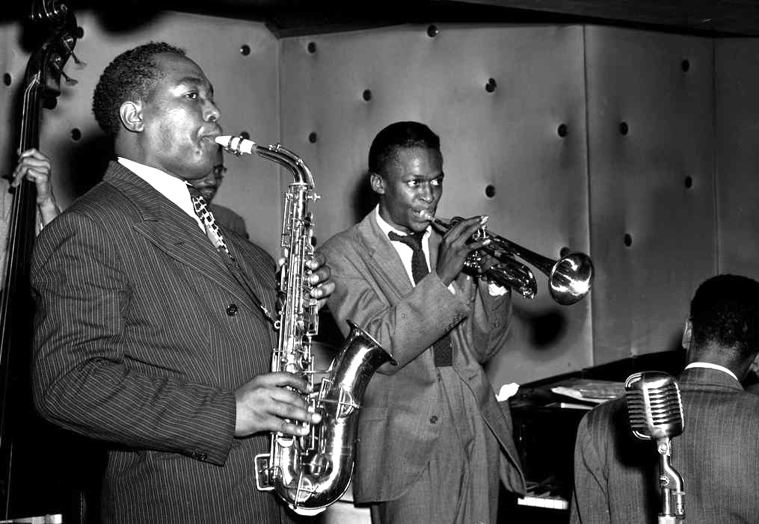
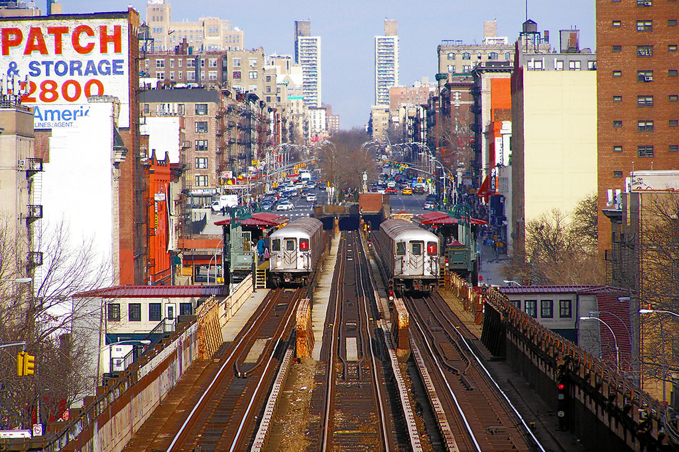
Culture
New York is known for the many American cultural movements that first emerged in the city.
The Harlem Renaissance: (also known as the “New Negro Movement”) a cultural, social and artistic explosion- took place in Harlem, New York 1920s.
The City of New York is an important center for music, film, theater, dance and visual art.
American modern dance developed in New York in the early 20th century.
The City was the top venue for jazz in 1940s, expressionism in 1950s and home to hip hop, punk rock and the Beat Generation.

Slide 9
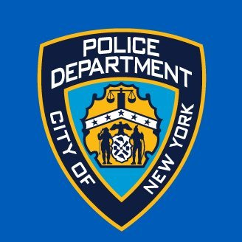
Police
The New York City Police Department (NYPD)
Established 1845
One of the oldest police departments established in the US
Chief: James P. O’Neill
No. of employees: 49,526 - as of 2013
Motto: “Fidelis ad mortem” - Latin for “faithful unto death”

Slide 10
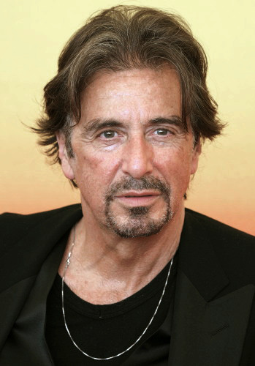
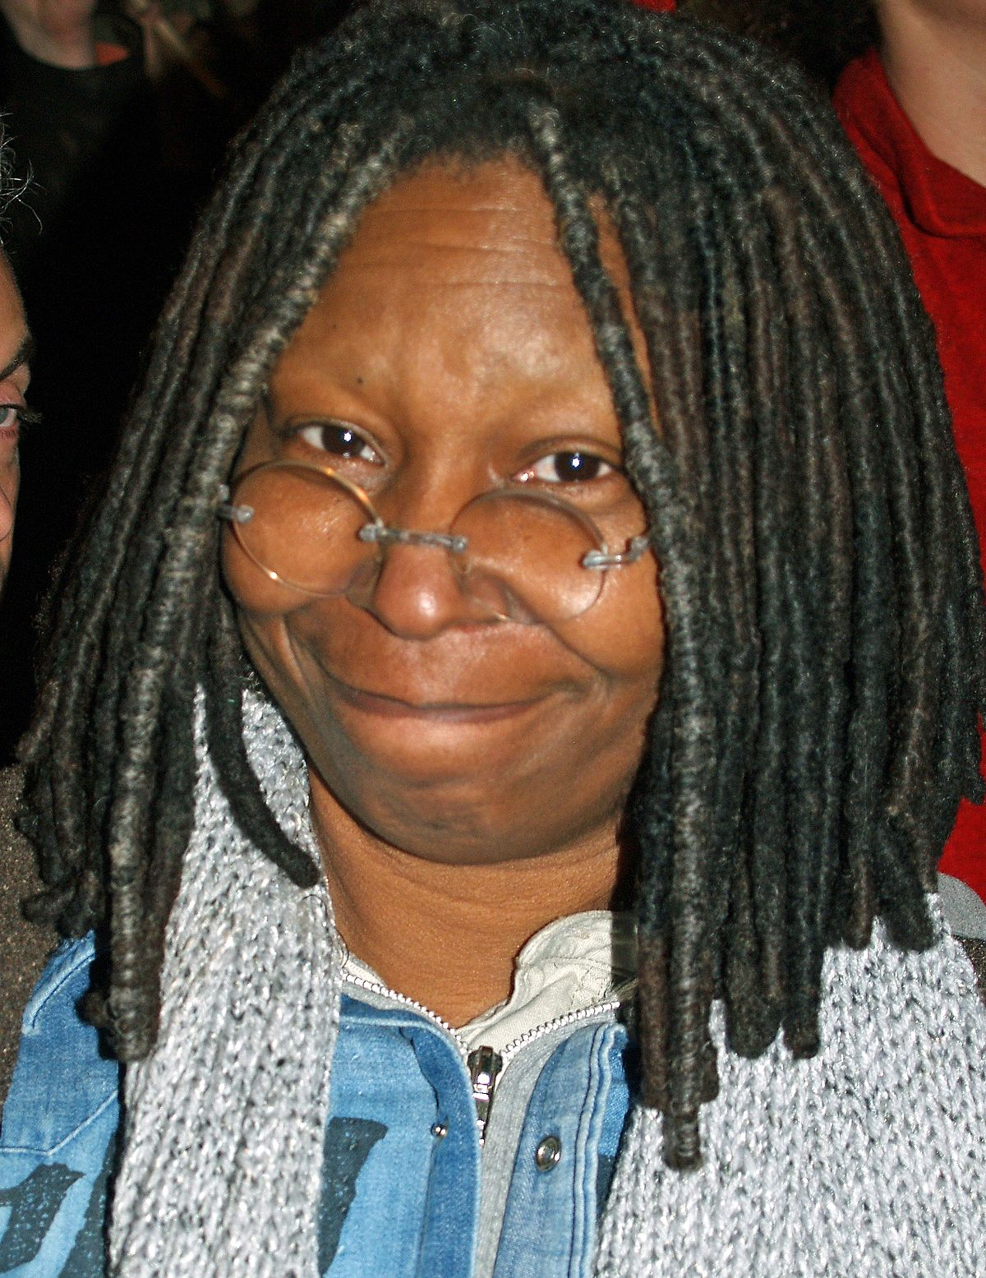
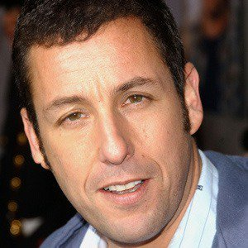
Famous Personalities
Lindsey Lohan
Anne Hathaway
Charlie Sheen
Adam Sandler
Alicia Keys
Whoopi Goldberg
Al Pacino
Ben Stiller
Donald Trump

